Slide 2
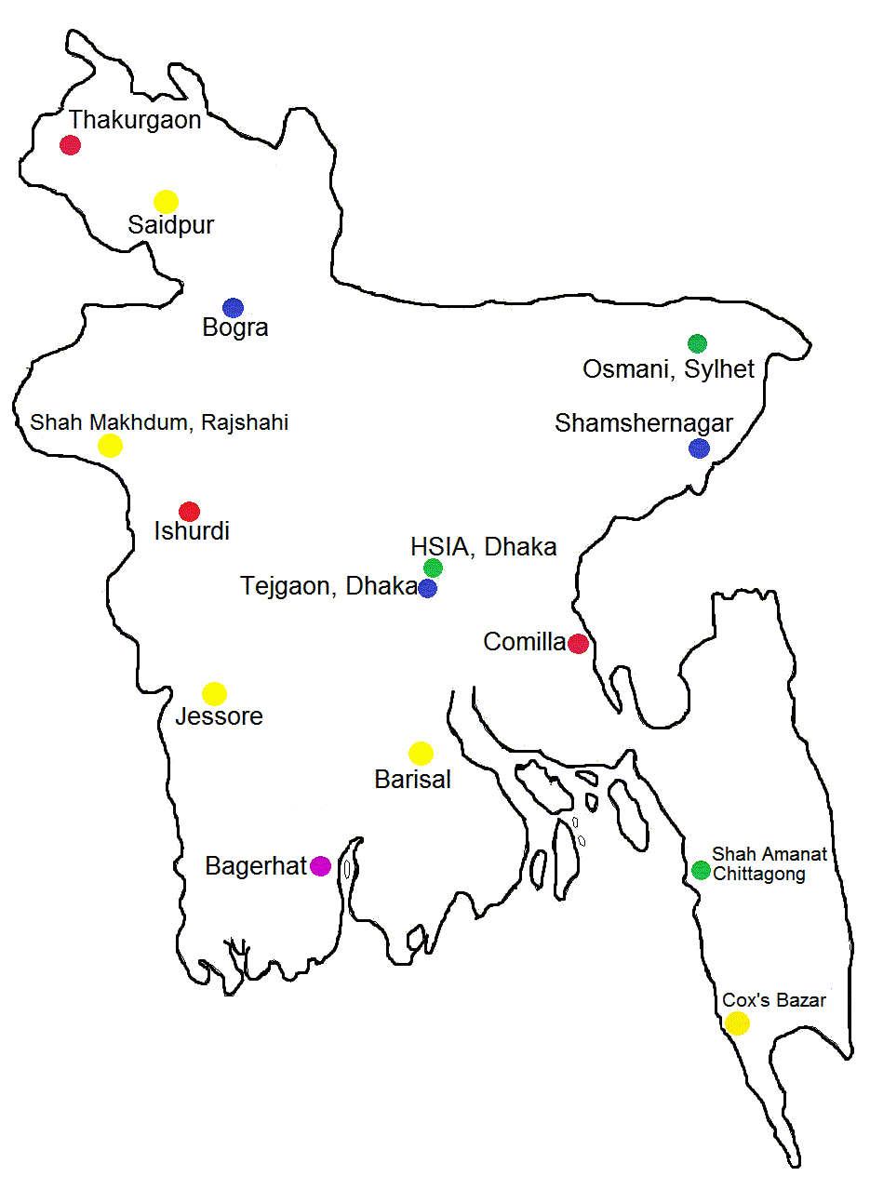
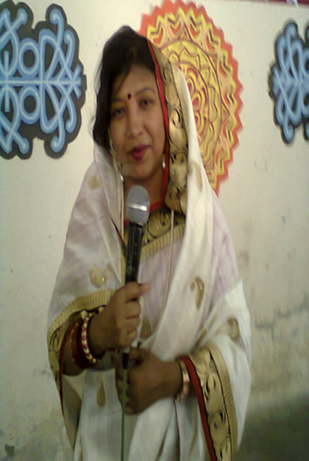

Slide 3
for
Safe Journey
To
My Eng. 1st Paper Class
Class-viii

Slide 4
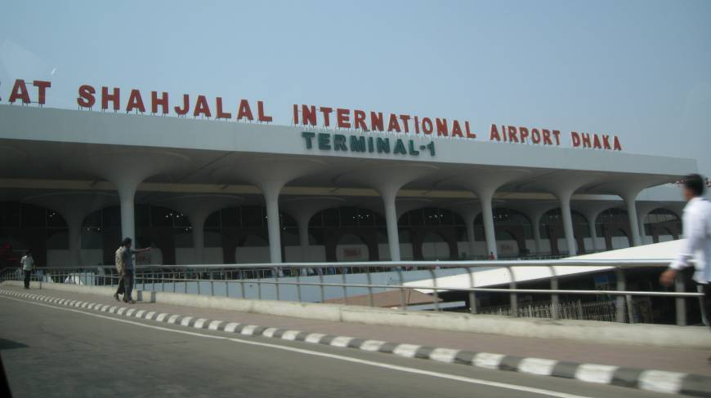
Legend under Bangladesh Map: 1. Green - International Airports 2. Yellow - Domestic Operational Airports 3. Blue - Airports where prior approval is needed

Slide 5
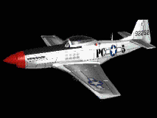
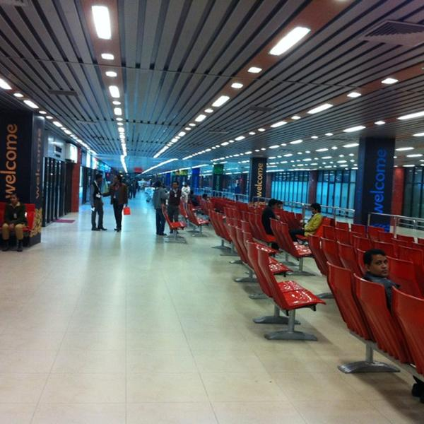
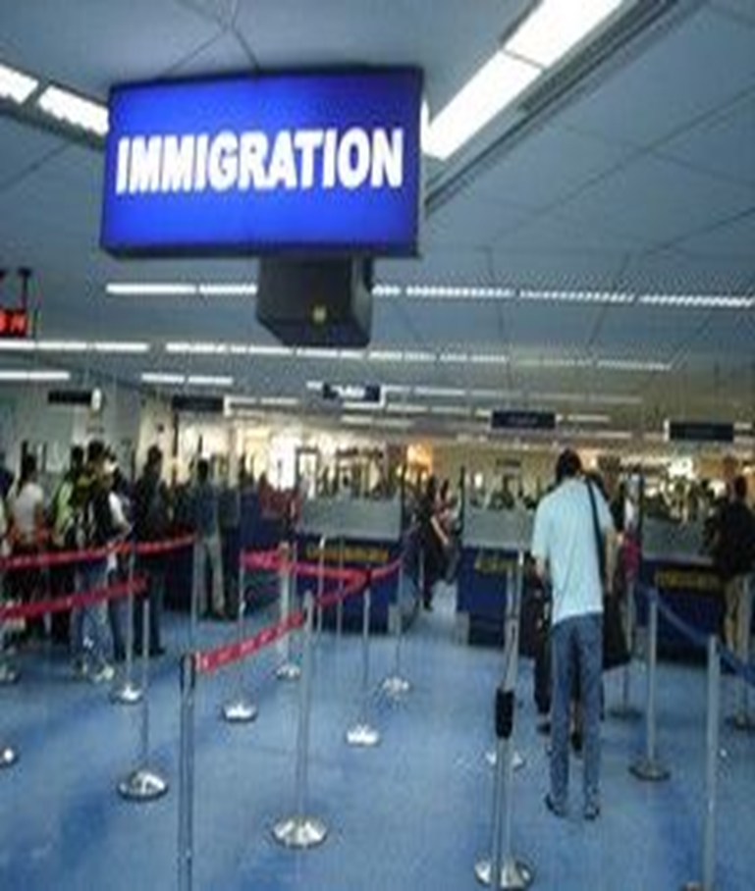
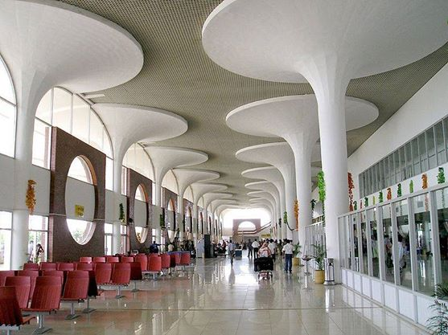
Today’s Topic
GOING THROUGH
IMMIGRATIN
GOING THROUGH
IMMIGRATIN
Lesson 3

Slide 6
LEARNING OUTCOMES
By the end of the lesson the learners will be able to
* talk about pictures
read a dialogue understanding it
ask and answer questions
make a list
act out a role play

Slide 7
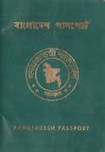
Pair Work : Before reading the text, look at the pictures and discuss in pairs /talk about the pictures.I will ask you some questions ,you will answer them.

Slide 8
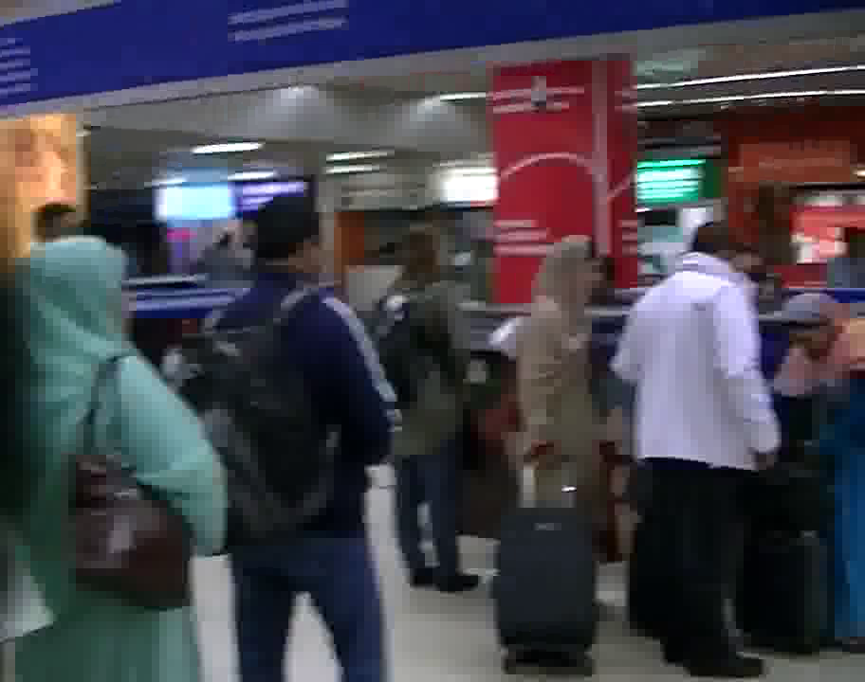
B .Text Reading: Read the text and answer following the questions .
1.Why does a person need a passport?
2.What are those booths for?
3.Why are people standing in a line in front of them?
4.What are the persons doing inside the booth?

Slide 9
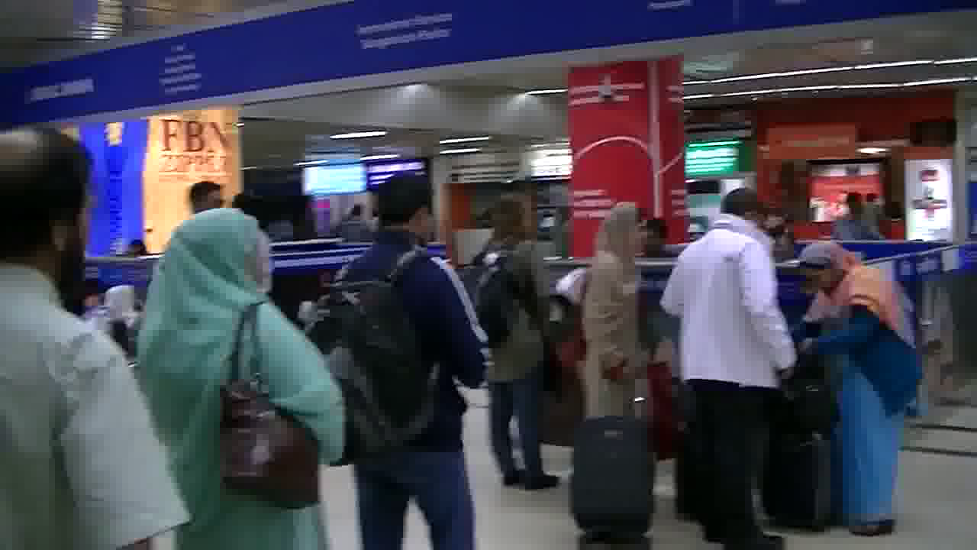
Immigration
(noun)
the part of a port, airport, etc where government employees examine the passports, visas, etc of foreign nationals entering the country
ˌ

Slide 10
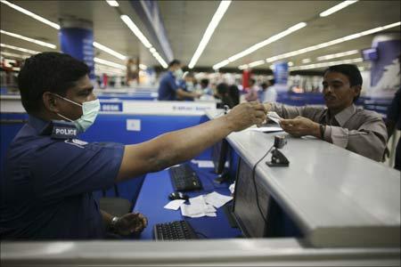
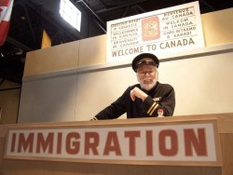
Immigration officer
a government employee who examines the passports, visas, etc of foreign nationals entering the country at a port, airport, etc

Slide 11
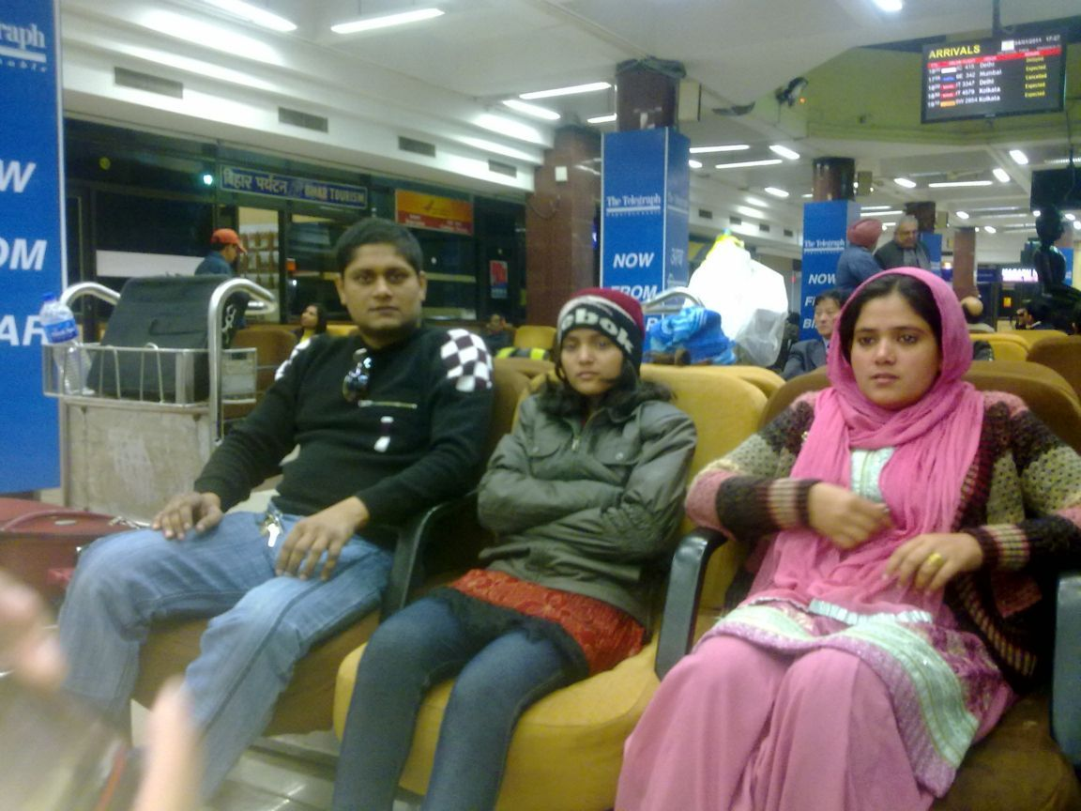
Departure Lounge (noun)
U.S
U.K
waiting area,
lounge
an area / a lounge with seating where passengers can await departure

Slide 12
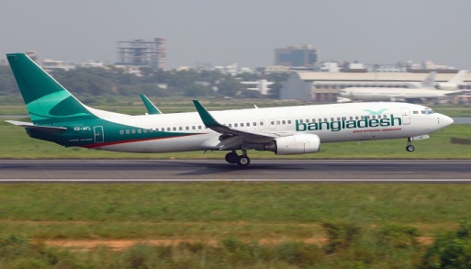
Departure (noun)
(d-pärchr)
The act of leaving
The plane is getting ready for departure .

Slide 13
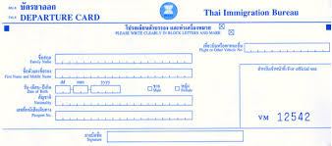
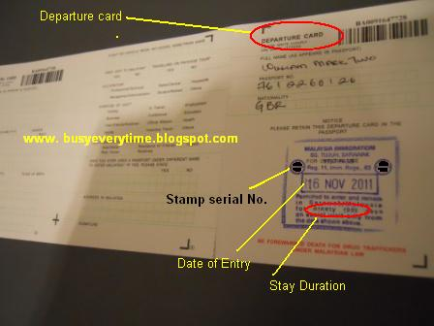
Departure
card
outgoing passenger card
or embarkation card
A departure card, also known as an outgoing passenger card or embarkation card, is a legal document used by immigration authorities to provide passenger identification and an effective record of a person’s departure from certain countries.
10 days

Slide 14
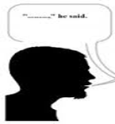
D. Act out the role of Mita and the Immigration officer.
C. Make a list first showing what the immigration officer asks and tells Mita and what Mita said in response.
Immigration officer
Mita
No , I’m Travelling with my aunt,
uncle and cousin.
Are you travelling alone?
Are they over thee right now ?
Yes , they ‘re waiting in front of
another counter.
Are you going to visit Thailand
for the first time ?
Yes, I’m going to visit Thailand
for the fist time.
Hou long are you going to
stay there ?
I’m going to stay there for
7-10 days.
I’m going to stay there
in a hotel.
Where are you going to stay ?

Slide 15
HOME WORK
E. Write the three things needed
at immigration.

Slide 16
THANK YOU VERY MUCH

Slide 17
Acknowledgement
MoE, DSHE, NCTB & A2I respective officials
And the editors panel:
Mr. Ranjit Poddar, Associate Prof, TTC, Dhaka,
Mr. Md. Jahangir Hasan, Asst. Prof, TTC, Rangpur,
Urmila Khaled Asst. Prof, TTC, Dhaka.
Their direction, valuable suggestions and intensive supervision have enriched the model contents.

